Slide 1
Course 227 Lab 2 – Getting Started with CST Microwave Studio Task for Week 3
Dr Harry Marks
h.marks@lancaster.ac.uk

Slide 2
Objectives:
Learn how to set up a simulation in CST Microwave Studio.
Simulate a section of straight WR10 waveguide.
Learn how to set up ports.
Collect data about the reflection and transmission via the S-parameters.
Understand how to view the E-fields throughout the structure.
Simulate for Part 2 of your final report an H-Plane T-Junction using the knowledge of CST you have just gained.

Slide 3
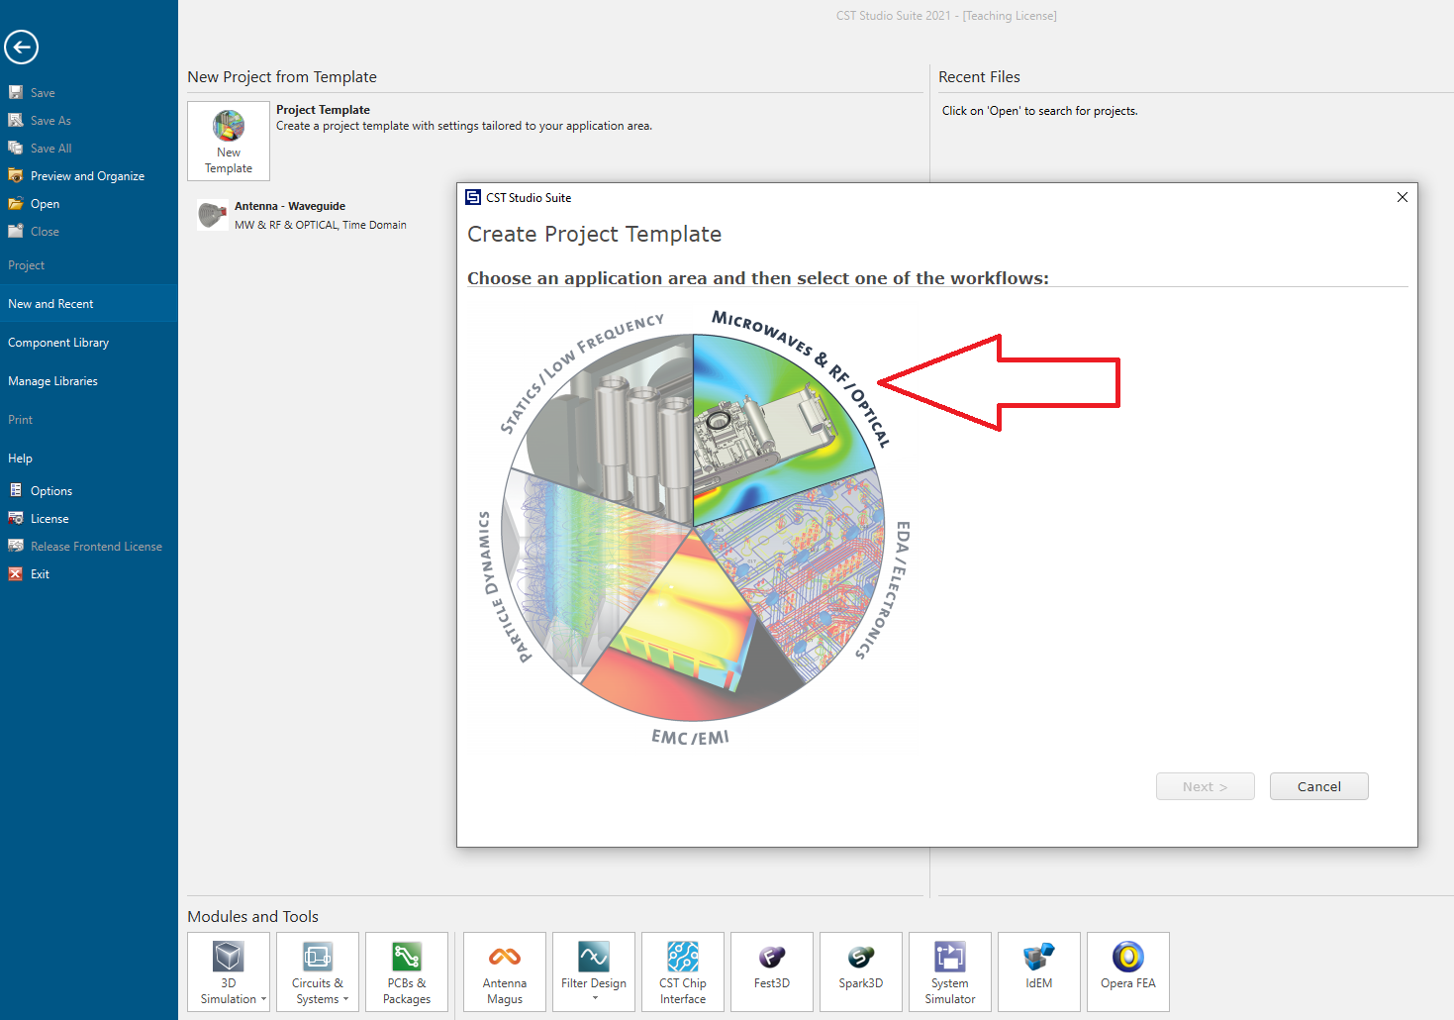
Once you’ve opened CST, select “Microwaves & RF/Optical”.

Slide 4
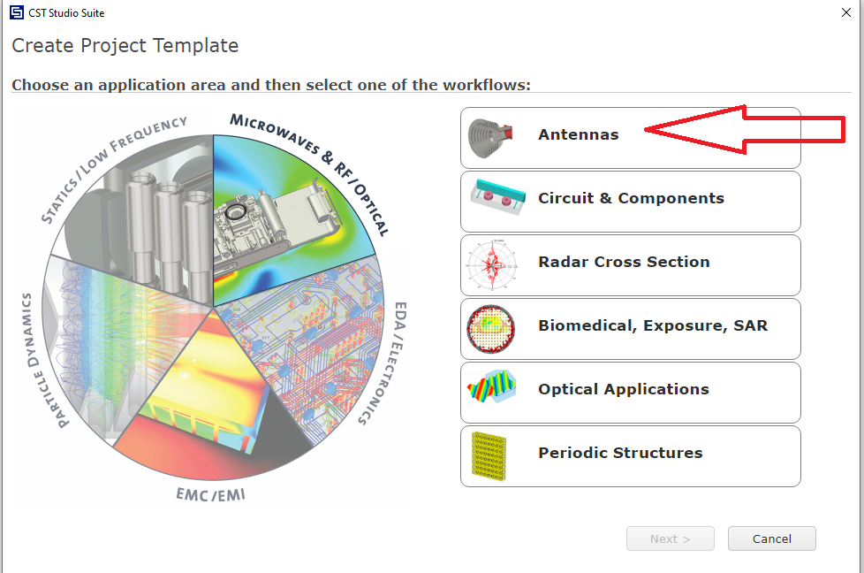
Select Antennas

Slide 5
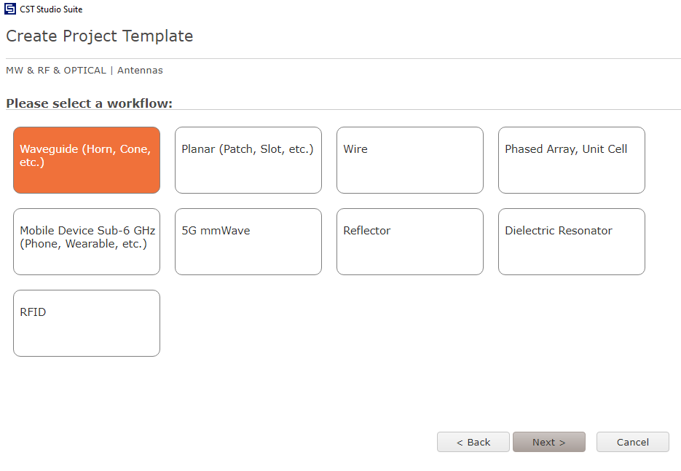
Select Waveguide

Slide 6
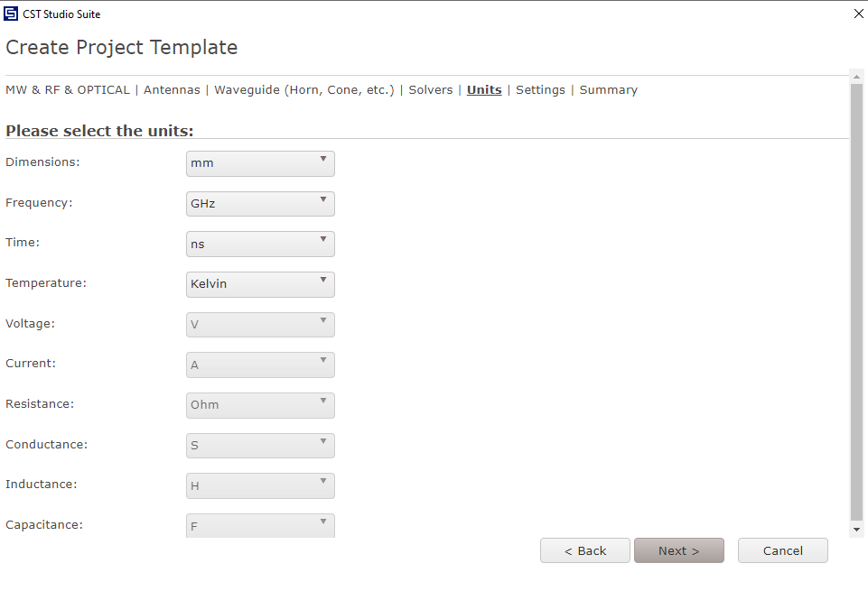
Use the suggested units.

Slide 7
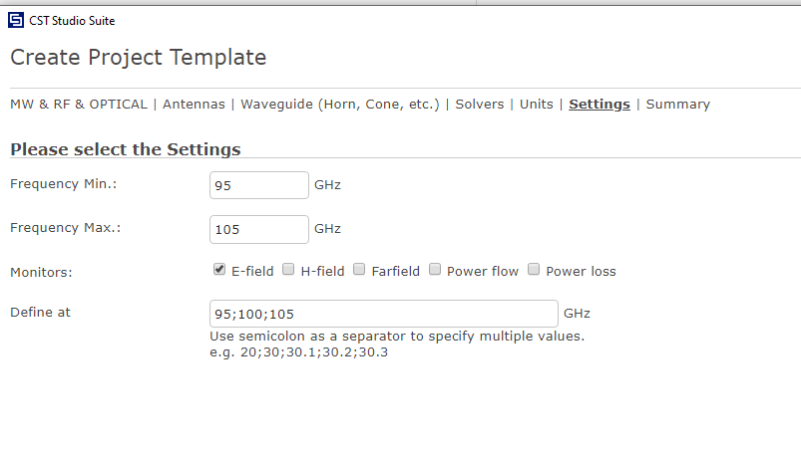
Enter this frequency range:

Slide 8
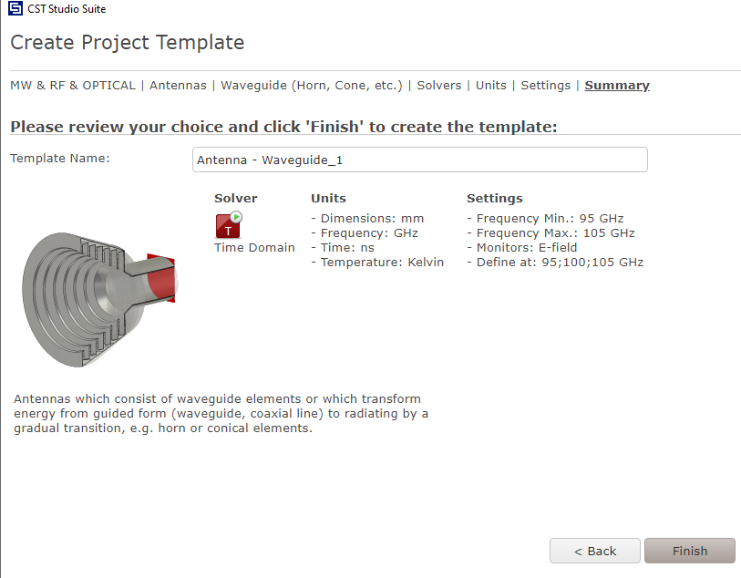
Name the Project Template.

Slide 9
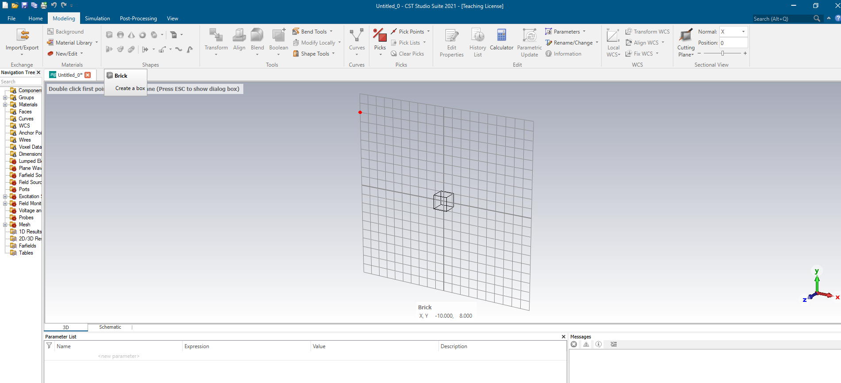
Select the “Modelling” menu and select “Brick”.

Slide 10
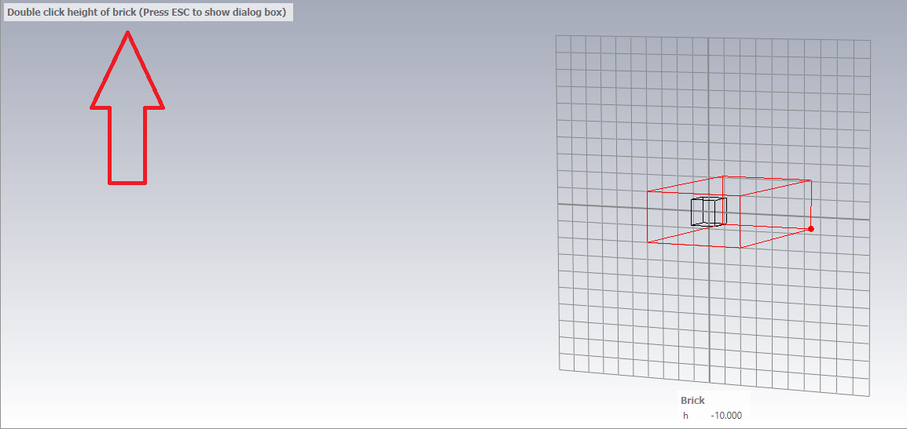
Double click to begin drawing the brick. Double click again to draw a rectangle. Then extend this out and double click again.

Slide 11
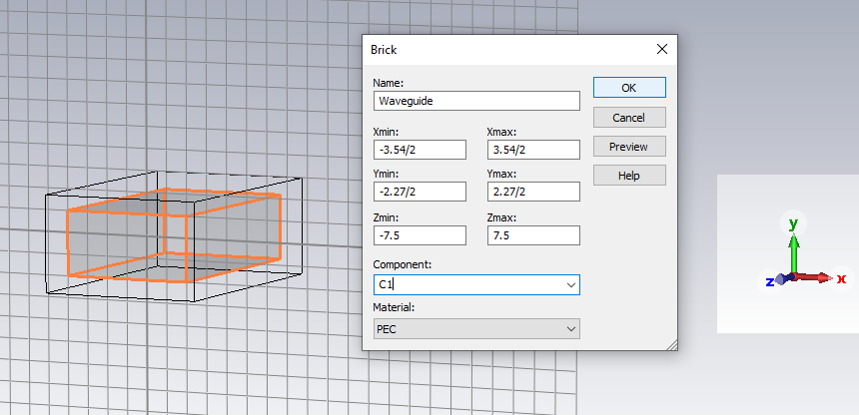
A menu will appear. Enter the dimensions shown below:

Slide 12
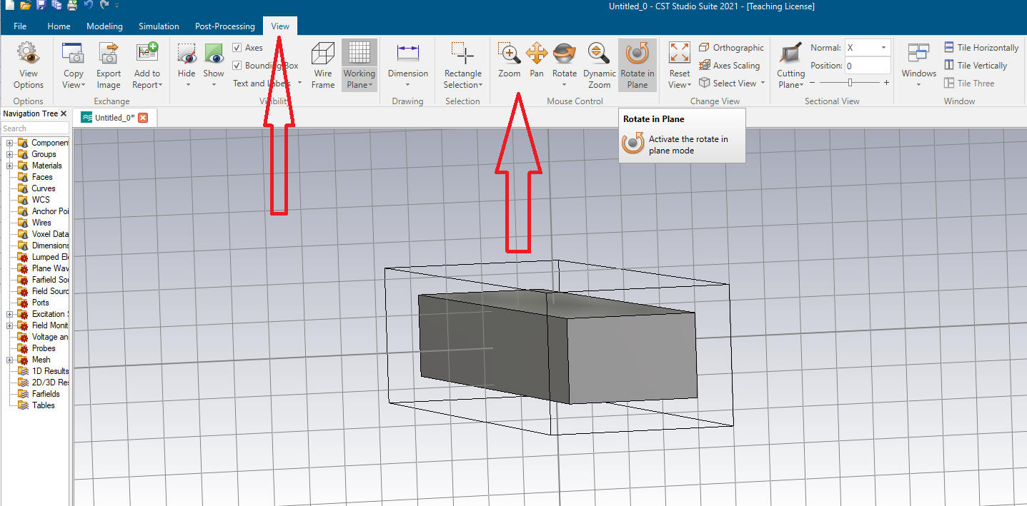
Our new object can be viewed from different angles.

Slide 13
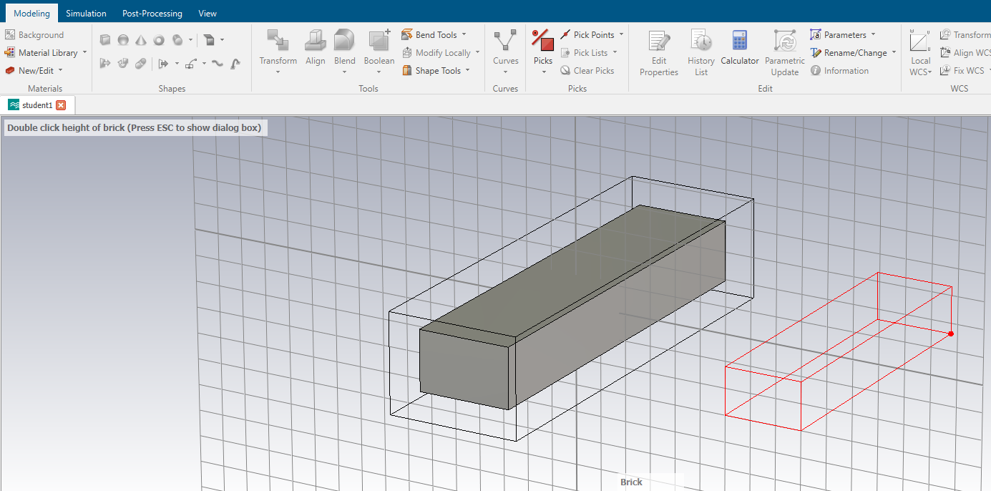
We have a solid shape. To create a waveguide we need to create a second structure. Select “Modelling”, then “Brick”, then draw a shape as before.

Slide 14
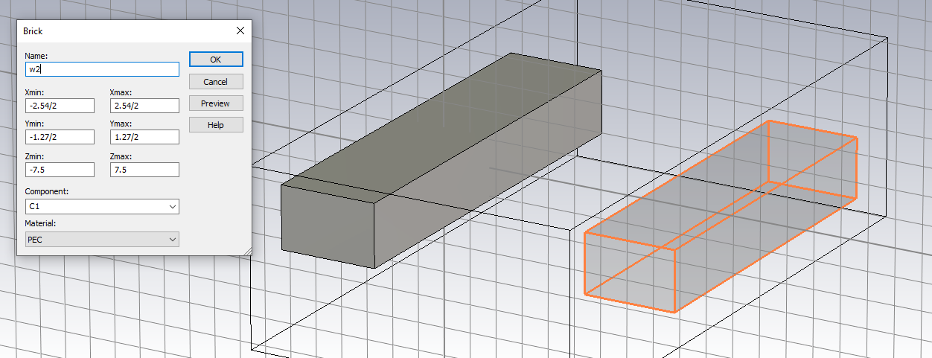
Please note the dimensions. A WR10 waveguide has internal dimensions 2.54 mm by 1.27 mm.

Slide 15
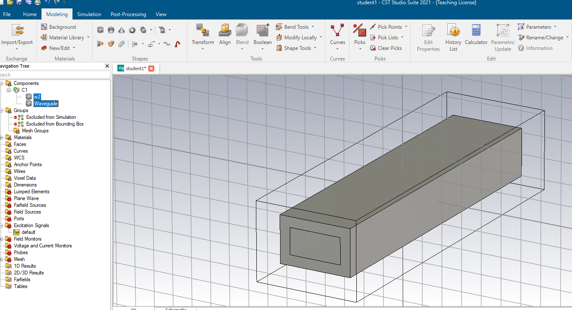
One structure is sitting on top of the other. To create a wave guide we need to subtract one from the other.

Slide 16
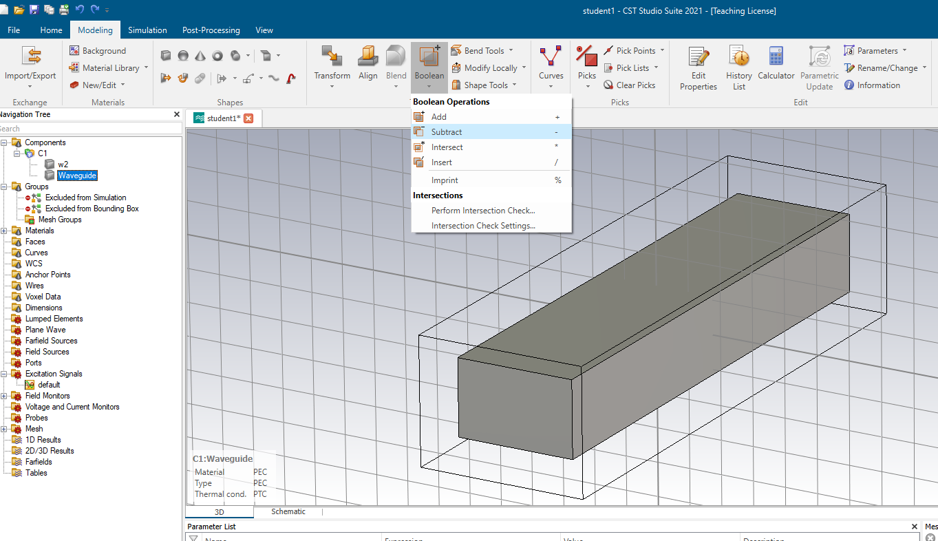
Click on the “Waveguide” component. Then Click “Boolean”. Then select “Subtract”. Then click “w2” and press enter.

Slide 17
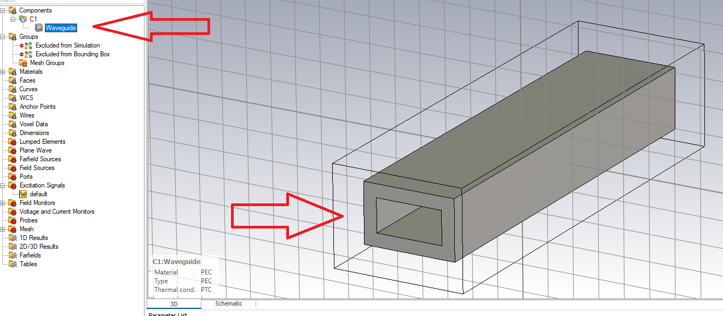
Now we have a waveguide. Note in the bottom left it says “Material PEC”. PEC stands for Perfect Electric Conductor.

Slide 18
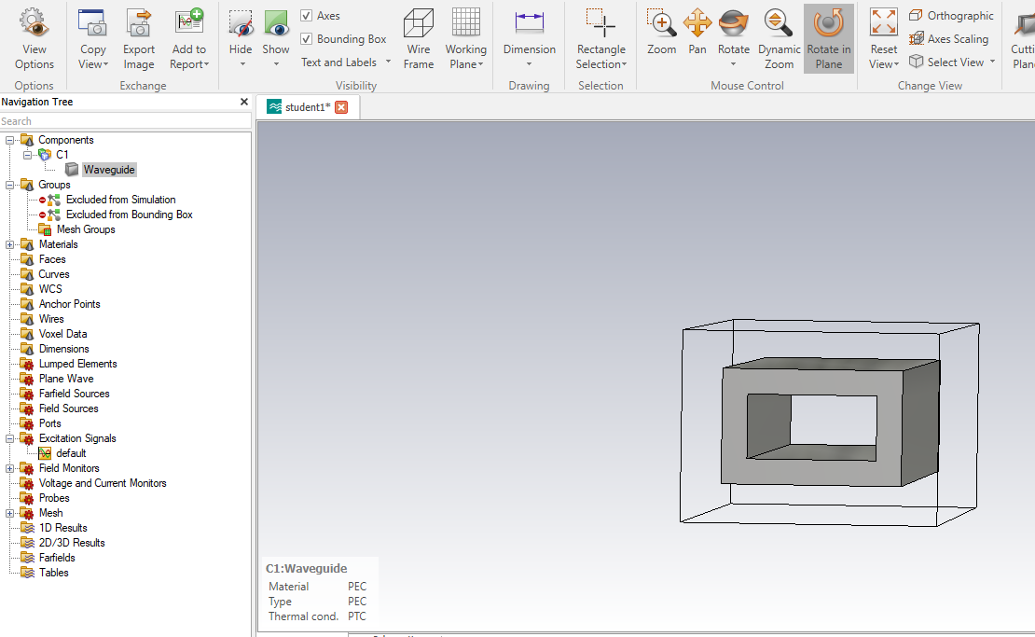
We now have a 15 mm long section of WR10 waveguide.

Slide 19
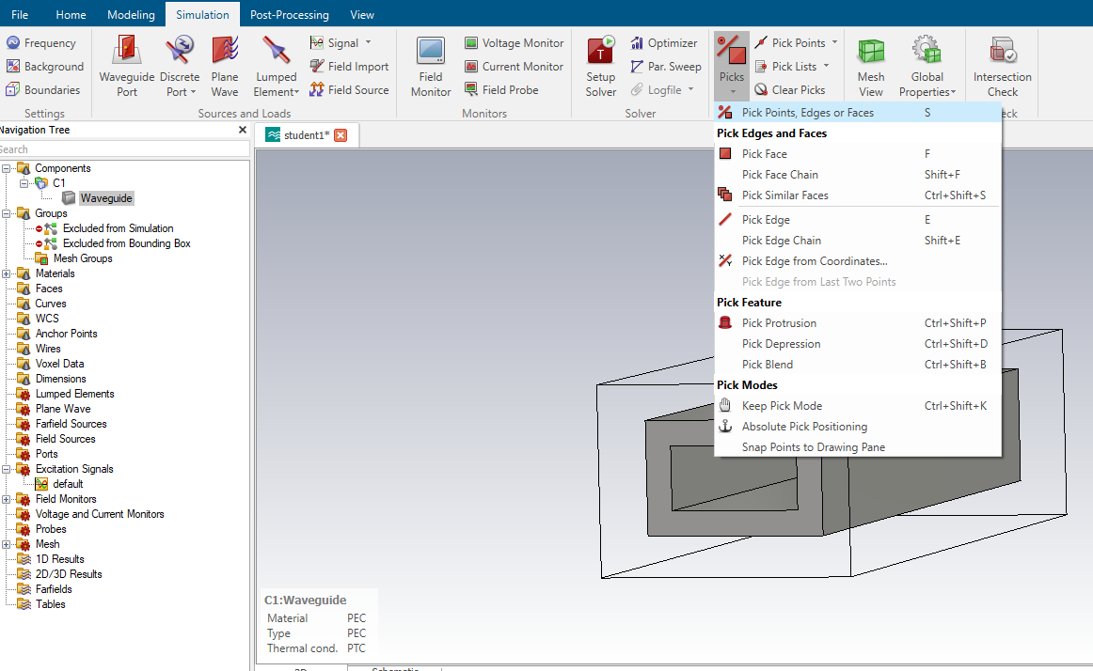
Now we’re going to define the ports. Click on “Picks” and select the top option. Or press “s”.

Slide 20
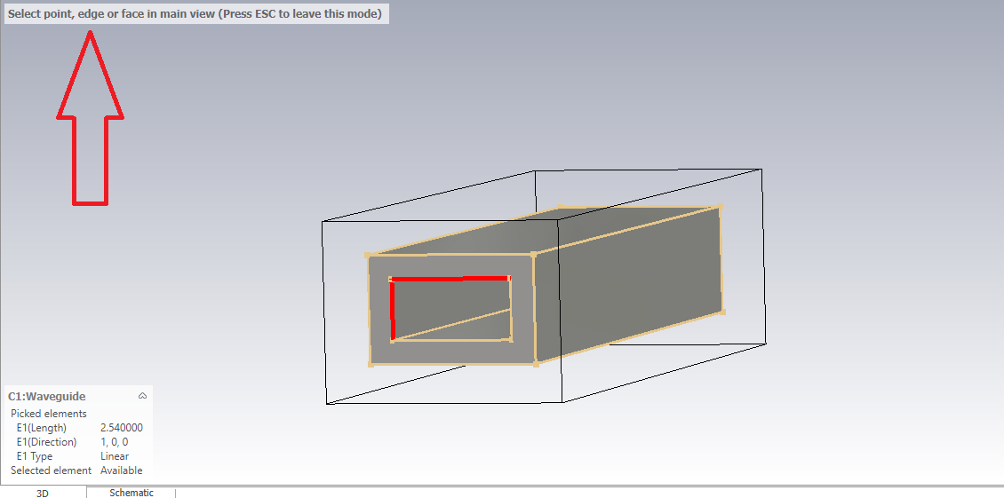
Press “s” then select an edge of the port.

Slide 21
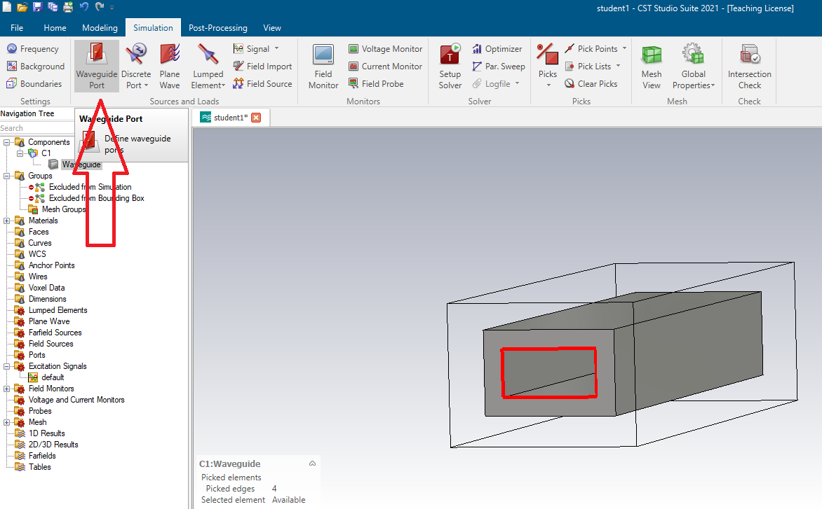

Slide 22
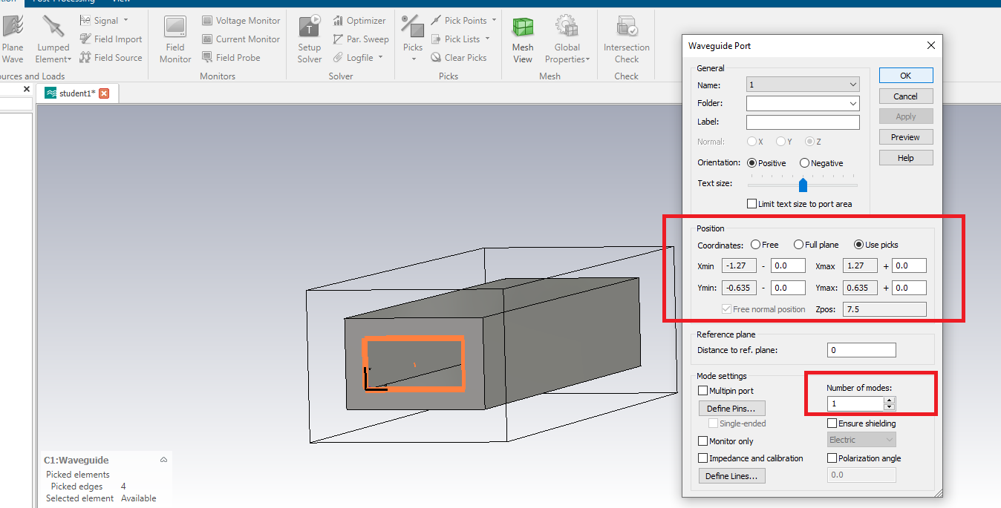

Slide 23
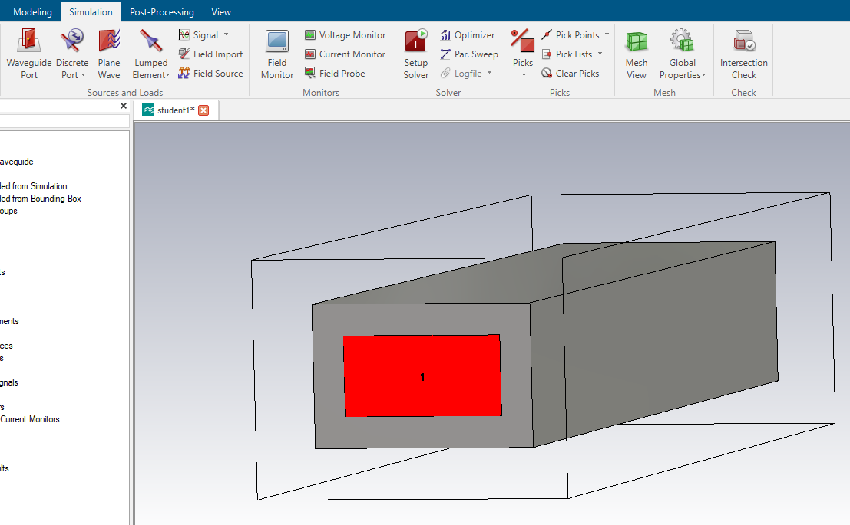
Port 1 is set up:

Slide 24
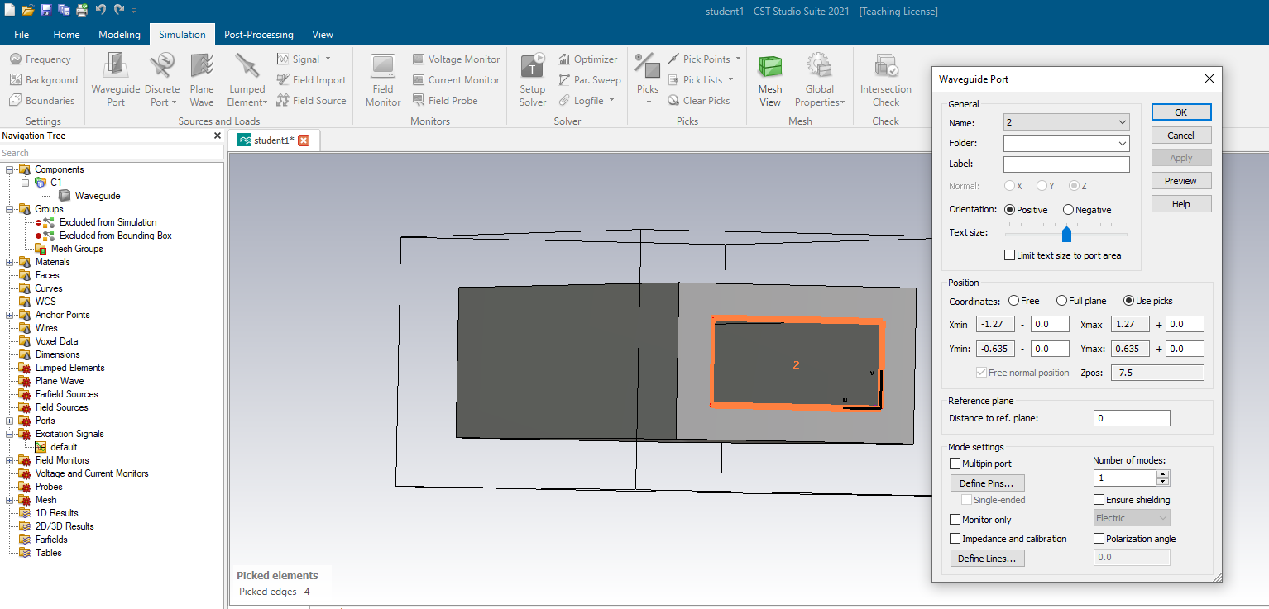
Setting up a port, port 2, at the other end of the waveguide:

Slide 25
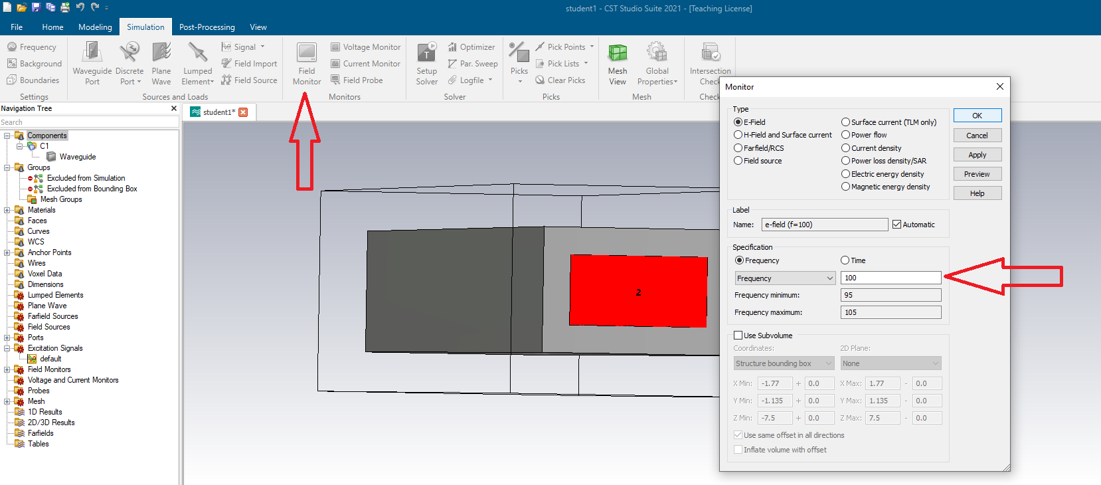
Select “Field Monitor”. Note the central frequency is 100 GHz.

Slide 26
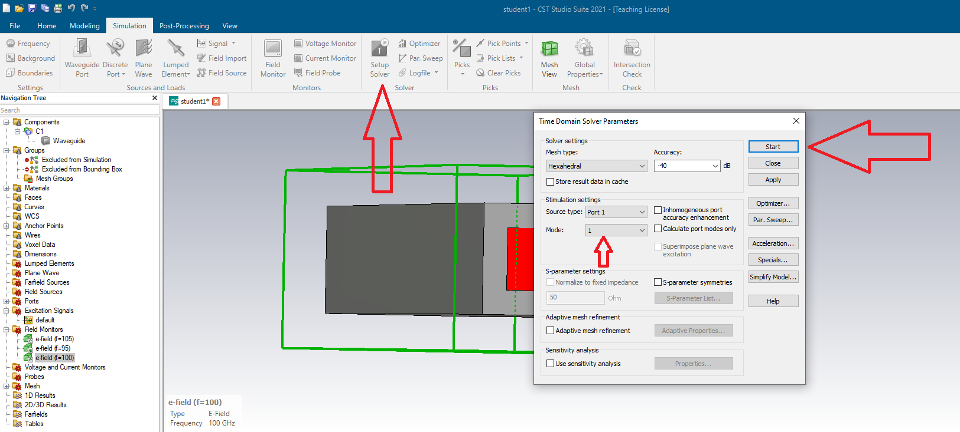
Click “Setup Solver”. Select Port 1 as the source and 1 mode. Then click Start.

Slide 27
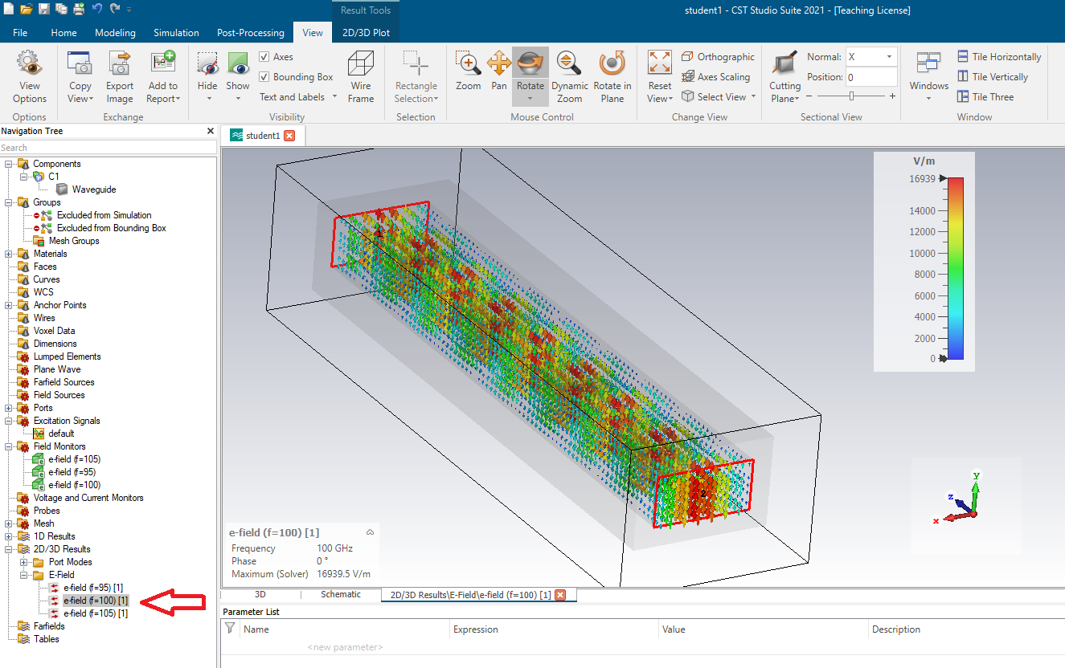
The field can be viewed in a number of ways.

Slide 28
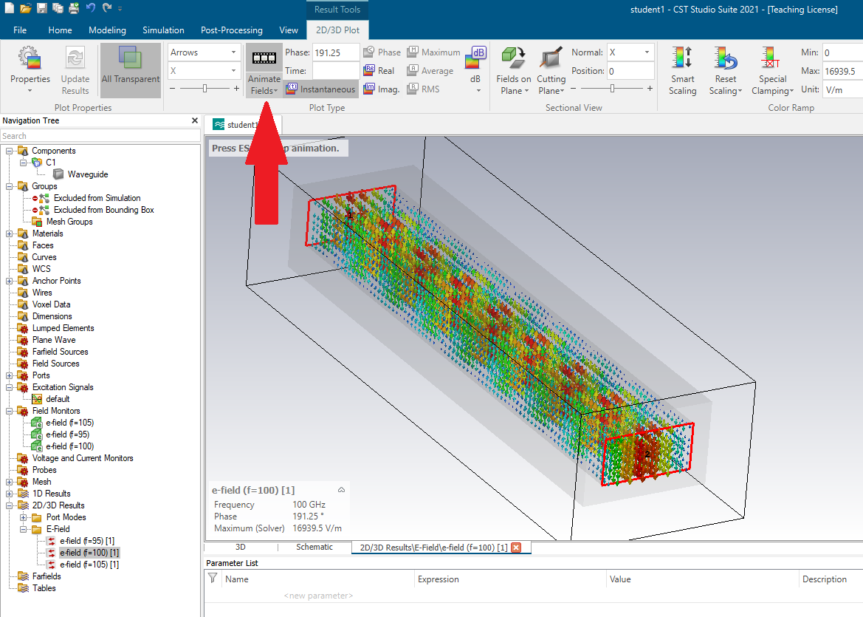
It can also be animated.

Slide 29
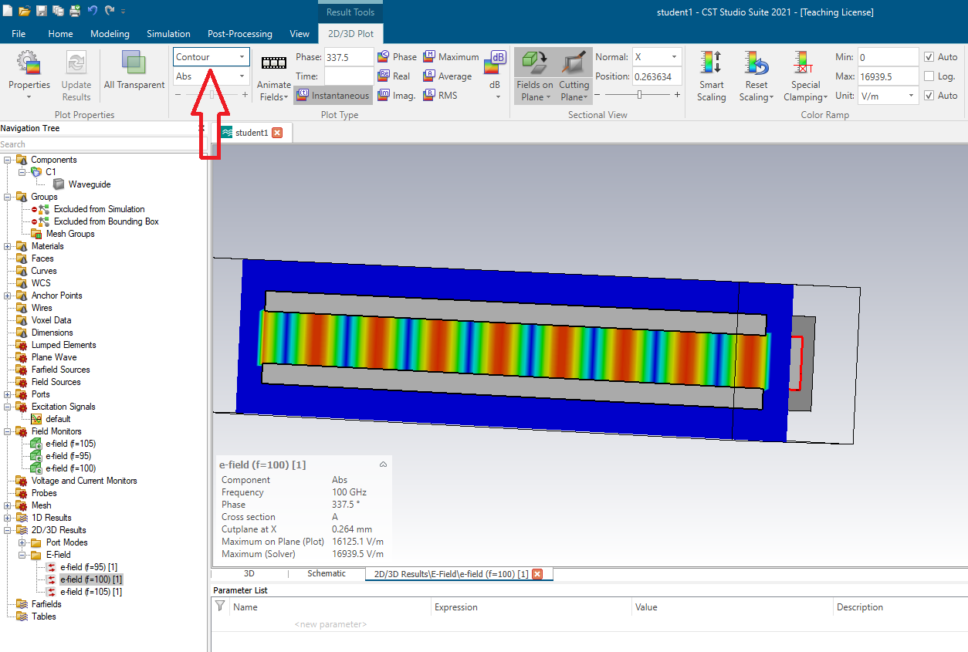
The field can also be viewed as a contour plot in different planes.

Slide 30
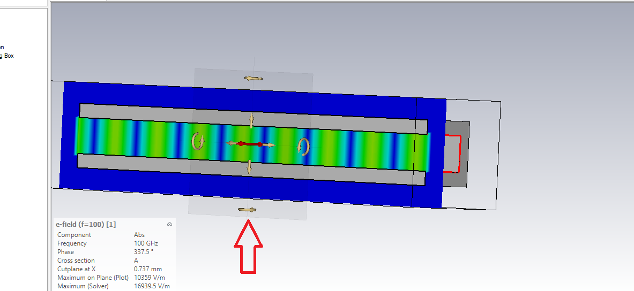
By clicking on the golden arrows the plane at which we are observing the electric field can be changed.

Slide 31
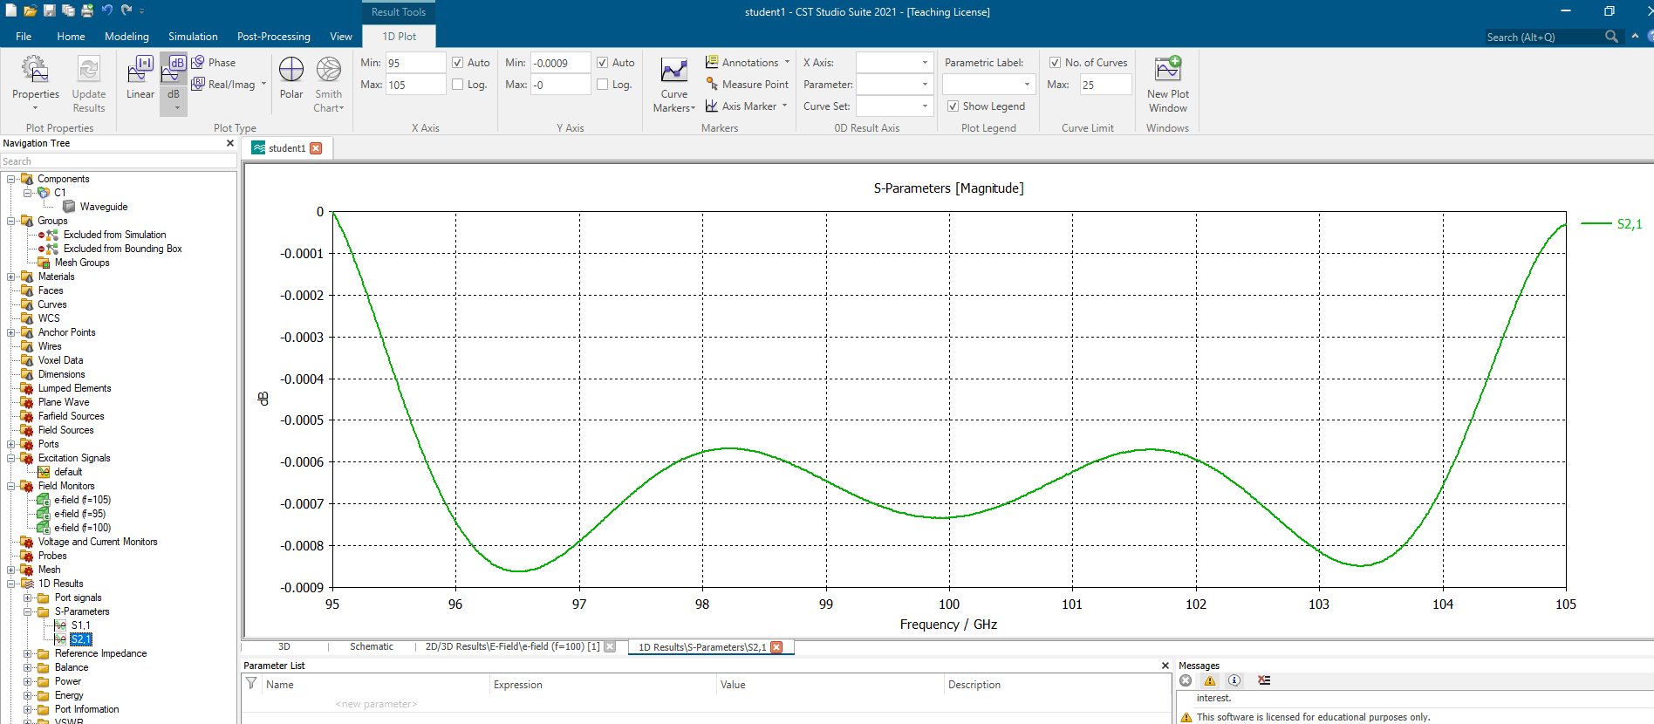
By selecting “1-D Results” from the menu on the left we can plot the S parameters.

Slide 32
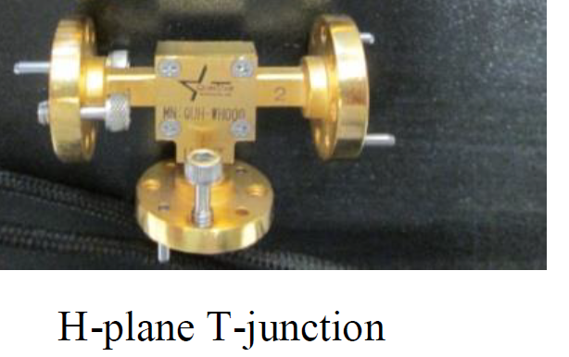
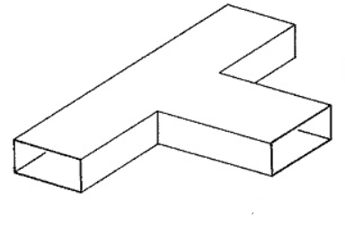
Objectives for the Final Report: Part 2
Build a simulation of a WR10 H-plane T-junction.
A picture of an H-plane T-junction is shown to the right. Of course, you do not have to include the flanges in the simulation.
Just viewing the interior guide in a semi-transparent way an example simulation is shown in the next slide.
Include in your report:
1D plots of all the scattering parameters, so S11, S12, S21, S13, S31, S23, etc… Where appropriate plots these on the same graphs (please don’t produce 9 graphs).
3-D plots in different planes (XY, XZ, YZ).

Slide 33
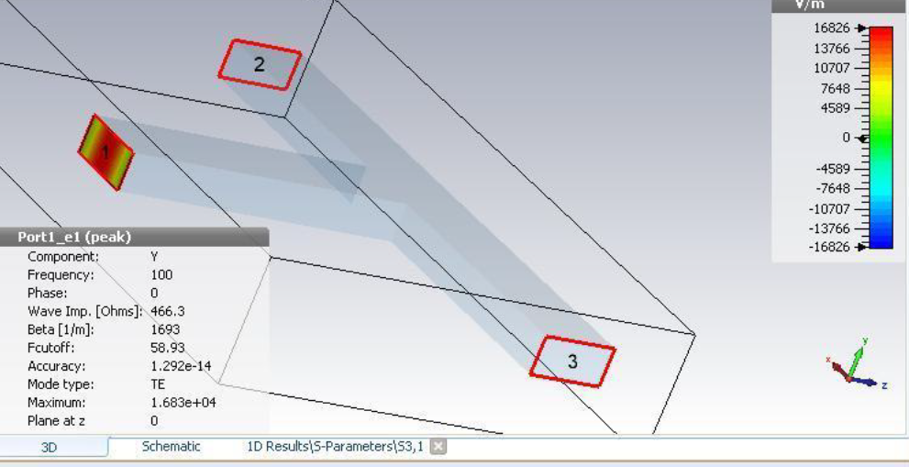
Example setup of an H-Plane simulation showing the interior walls.

